Slide 1
Submitting a Tiny Tapeout Design with HDL
Anthony Rizzuto

Slide 2


Starting a design with HDL
Common HDL softwares
Open-Source
Icarus Verilog
Paid Software
ModelSim (free with student edition)

Slide 3
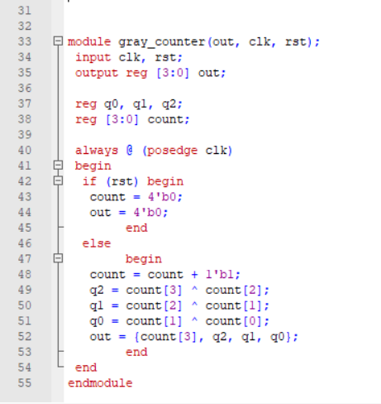
Compile Design
Compile design within chosen software
Example code is for a 4 bit gray code counter

Slide 4
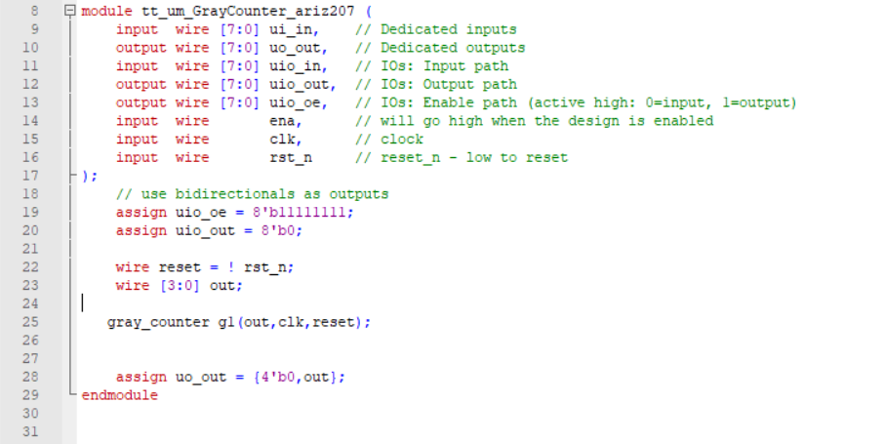
Format for Tapeout Submission
The module must have these input/output ports to be compatible with the tiny tapeout submission
This example is the parent module of the gray code counter

Slide 5
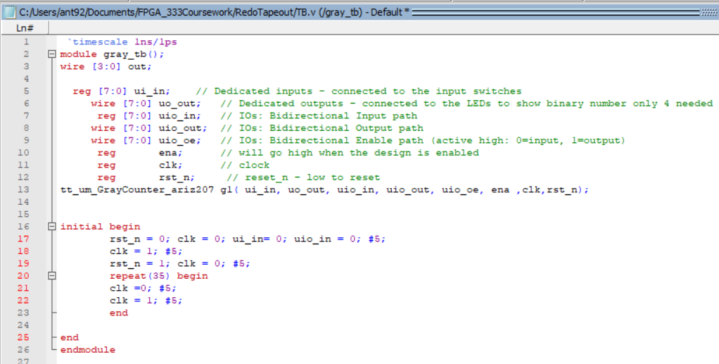
Validate with Testbench and Waveforms

Slide 6
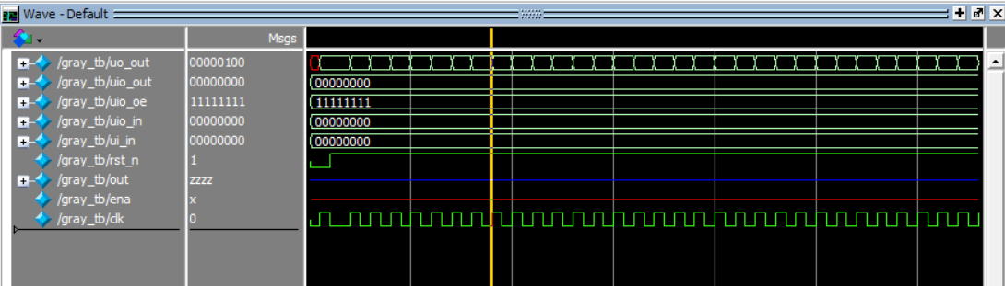

Slide 7
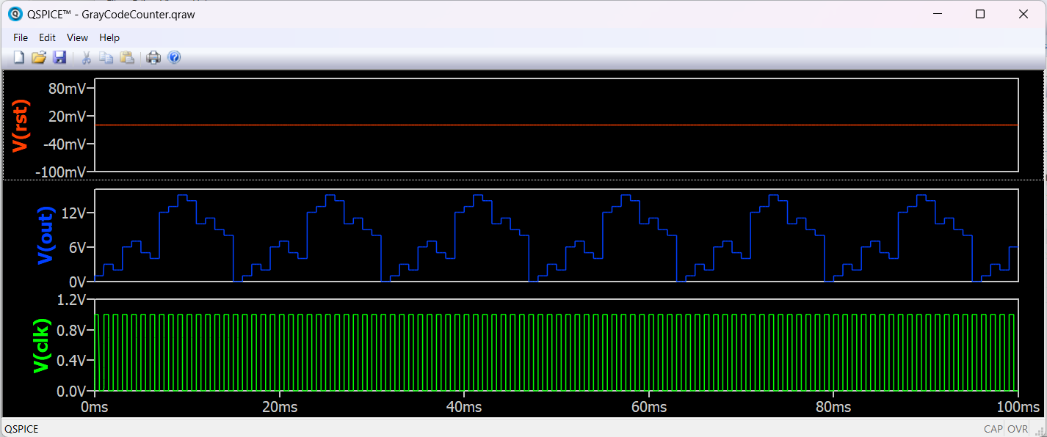
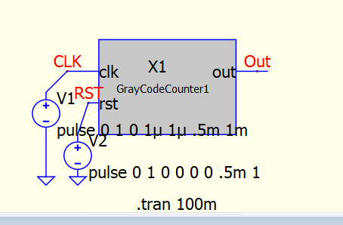
Validating on Another Open Source Software
QSpice software used to validate verilog code
Qspice circuit
Simulation Results
Further Information with QSpice: https://docs.google.com/presentation/d/15LKKdKU3QRi1gloOrpB0ECri9mg35lLX84K2yBC2cYc/edit?usp=sharing

Slide 8
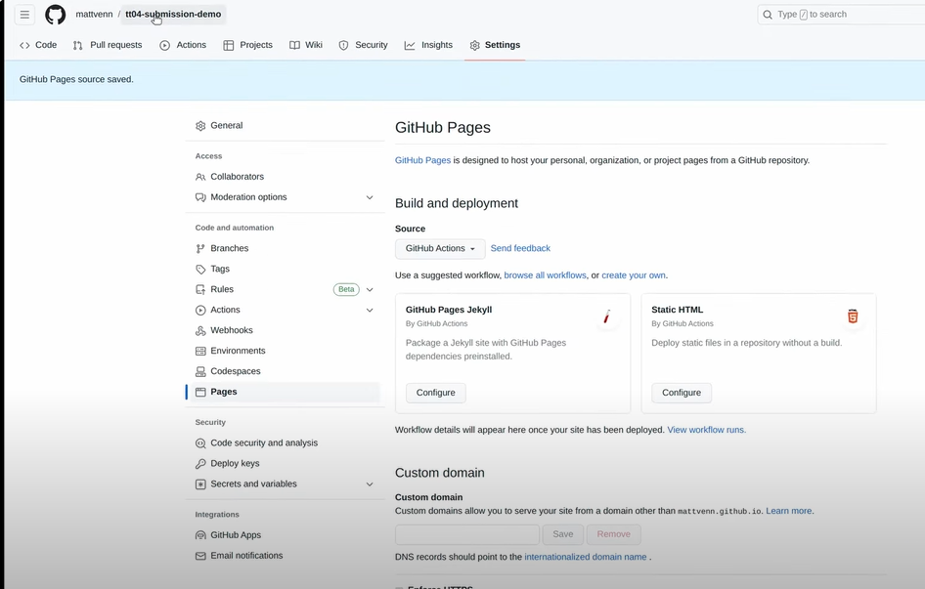
Bringing the Code to Github
Repo the github from the submission template in the Important Links slide below
Turn on Github actions in settings under the pages tab underneath source

Slide 9

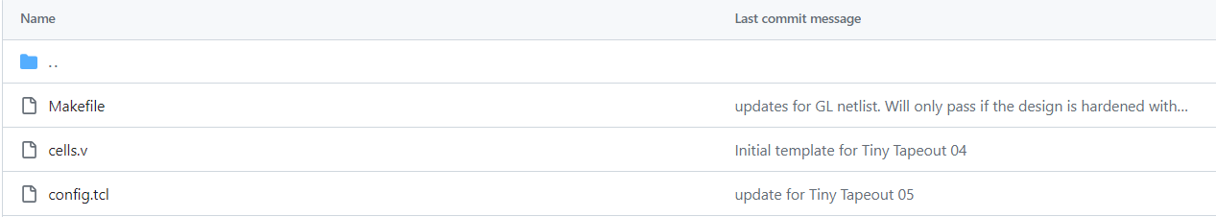
Upload source files
In the src folder of the main page
upload verilog files including testbenches

Slide 10

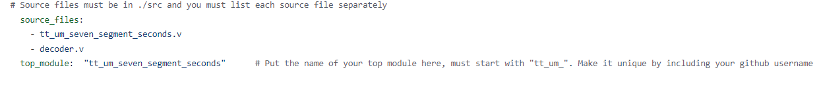
Update info.yaml file in github
List the source files that were placed in the src folder and the top module
Update the documentation segments with your information, i.e author, title, language used, description of design, testing, and inputs/outputs
Commit changes

Slide 11
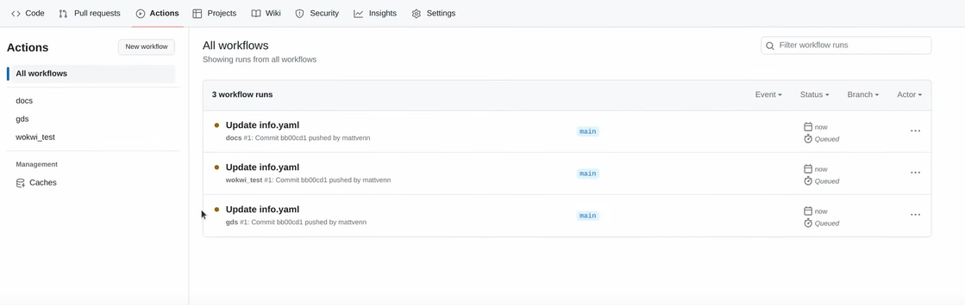
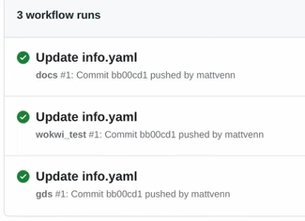
Actions Results
Verify the src info.yaml files were incorporated correctly into the github repository under the actions tab

Slide 12
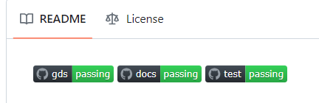
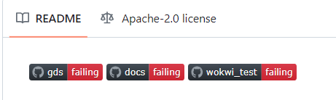
Verifying the Repository Passes
The gds, docs, and test boxes will inform if everything is compiled correctly and all the actions pass
Any errors result in a red fail box pertaining to whichever category

Slide 13
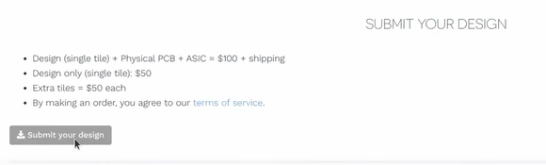
Submission to Tapeout
The final thing to do after ensuring the github repository actions are working would be to:
Go to the tiny tapeout website :
https://tinytapeout.com/
Hit the submission button on the bottom of the first page
Link your github account and submit the URL of the repository

Slide 14
Important Links
Tiny Tapeout Working with HDL
https://tinytapeout.com/hdl/
Matt Venn Tapeout submission video
https://www.youtube.com/watch?v=m62HLt4BjeA
Tapeout 5 Github Submission Template
https://github.com/TinyTapeout/tt05-submission-template
Tapeout 5 submission example
https://github.com/TinyTapeout/tt05-verilog-demo
Icarus Verilog Download Tutorial
https://www.youtube.com/watch?v=3Xm6fgKAO94
Actions Failing Submission Help
https://www.youtube.com/watch?v=m62HLt4BjeA
Timestamp for help 04:07

